Slide 1
CRC Cards
By James Moran

Slide 2
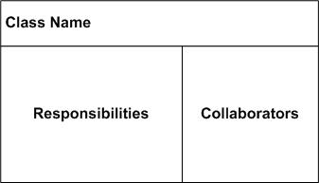
What are CRC Cards?
CRC: Class Responsibility Collaborator cards
Class: Top-Left Corner
Responsibility: Left-Hand side, under Class
Collaborators: Right hand side
(Rebecca Wirfs-Brock, 2009)
(Scott W. Ambler, 2014)

Slide 7
The drawbacks of using CRC cards
Possibility of Low Cohesion and High coupling
Macho Classes
No clear role is defined
(Mohamed Fayad et al, 2003)

Slide 8
References
http://www.informit.com/articles/article.aspx?p=1391208
http://agilemodeling.com/artifacts/crcModel.htm
https://www.youtube.com/watch?v=Bxgn6qJ-bYY

